Slide 1
Warehouse Management System
CS 458 Final Project

Slide 2

What Is The Issue
Warehouse systems need management regarding several parts:
Inventory
Delivery
Orders
Sales

Slide 3

Why Solve It
Keep track of important info:
Sales/Orders - Know what items to order more of, less of, etc.
Inventory - Updated list of items currently in stock, overstocked

Slide 4
How To Solve It
Create data tables holding necessary information
Ease of access to all information
Allow admin management w/ functions:
Add/Edit/Delete items
Edit orders

Slide 5
How To Solve It (cont.)
Specific data tables:
Inventory, sales, orders, delivery

Slide 6
Outcome & Status
All HTML pages
Index page
Separate pages per table
Required tables
Inventory
Sales
Orders
Delivery

Slide 7
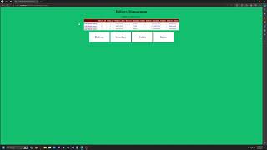
Demo

Slide 8
Impact
More work required to implement further
Integrate with official website
Manage deliveries/orders, etc.
Ability to update from customer order
Seamless updates

